Slide 1
JS ASYNC
Evolution

Slide 2
Node JS
Node.js® is a JavaScript runtime built on Chrome's V8 JavaScript engine. Node.js uses an event-driven, single threaded, non-blocking I/O model that makes it lightweight and efficient.

Slide 3
Single threaded JS
As JS is single threaded
only one instruction is executed at a time,
programs are executed without any pause from the beginning to the end (except for generators and async/await)
there is no parallelism at all

Slide 4

Callbacks

Slide 5
Callbacks
Native approach in node.js
Most primitive way to handle async execution
Error handling by convention only
Error prone
Code gets hard to reason about
Callback hell...

Slide 6
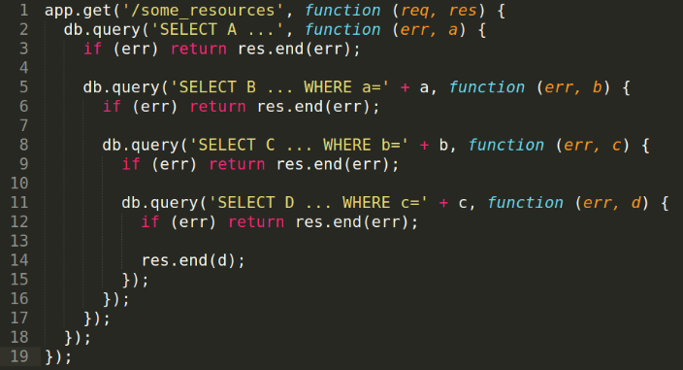
Callback hell

Slide 7
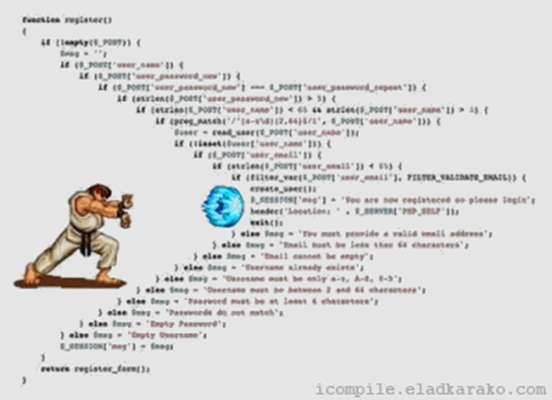
Callback hell

Slide 8

Promises

Slide 9
Promises
2 generation of async js
Included in the language since ES2015
Centralized error handling through “catch”
Better flow control, via array methods, still hard to implement conditionals
Code gets stills requires prior knowledge to reason about
Verbosity
Still no so readable
Newcomers to the language struggle with this

Slide 10
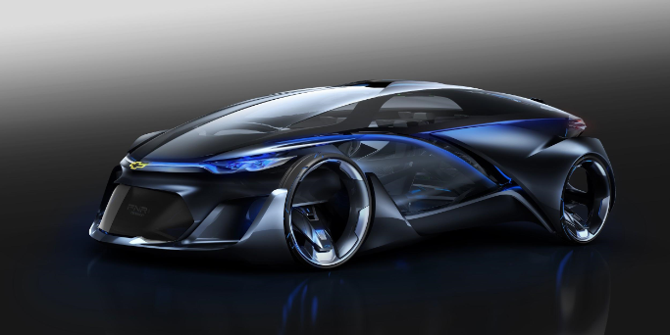
Async / await

Slide 11
Async/await
3th (4th?) generation of async js
ES2017 (can be used in node 7 under a flag)
Relies on promise
Works with try/catch
Written as synchronous code
Absolute control flow
Easy to reason about

